Slide 1

Maker Badges
An open badge system for educators
Documented by Benjamin James SImpson

Slide 2
Design:
the planning and creation of new things

Slide 3
Our goal is to increase the presence of design in education.

Slide 4
States of design
A model to consider
Digital
Mental
Physical

Slide 5
systems of Design
Called
“Maker Badges”
Digital
Mental
Physical

Slide 6
- Developed by Educators from Shenzhen & San Francisco - Clear and flexible classroom goals - Room for the system to grow
Maker Badges

Slide 7


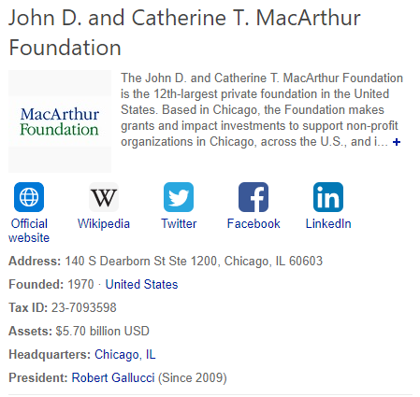

Based on Open Badges
Standards researched and promoted by multinational interests

Slide 8


Teacher Usage Scenarios
Teachers, reviewing their lesson plans, consider Maker Badges when listing educational objectives.
Some Badges are for classroom experiences already in the teacher’s lesson plan, the teacher now has the ability to highlight these experiences with a standardized format.
Some Badges are not in the planned lessons, but the teacher can see that adding them in would benefit their overall lesson objectives. The teacher can modify their plans, and highlight the additional achievements with ease.
Interviews
Lesson Plan

Slide 9
Suggested for year 2 rollouts
Additional Tools Available
Student Performance Assessments – Marzano Scale
Leadership, Social Skills, Community Service Framework
Observed
Level 1
Assisted
Level 2
Performed
Level 3
Taught
Level 4
Leadership
Service
Teamwork
Character
←

Slide 10
Our goal is to increase the presence of design in education.
For questions and next steps, contact:
Benjamin James Simpson
EIN Community Partner Manager, SteamHead Manager
205, Building A, Hua Guo Shan, Shekou, Shenzhen
WeChat: boomtown001
Email: james.xps@outlook.com

